Slide 1
Pine wood cafe
Anurag Jaswal (2111981049)
Ansh Verma (2111981044)
Anup Kumar Duya(2111981048)
Biswajit Paria (2111981060)

Slide 2
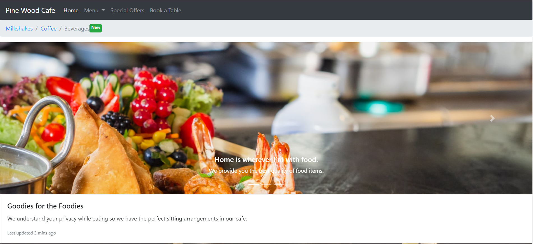
Home Page of our site

Slide 3
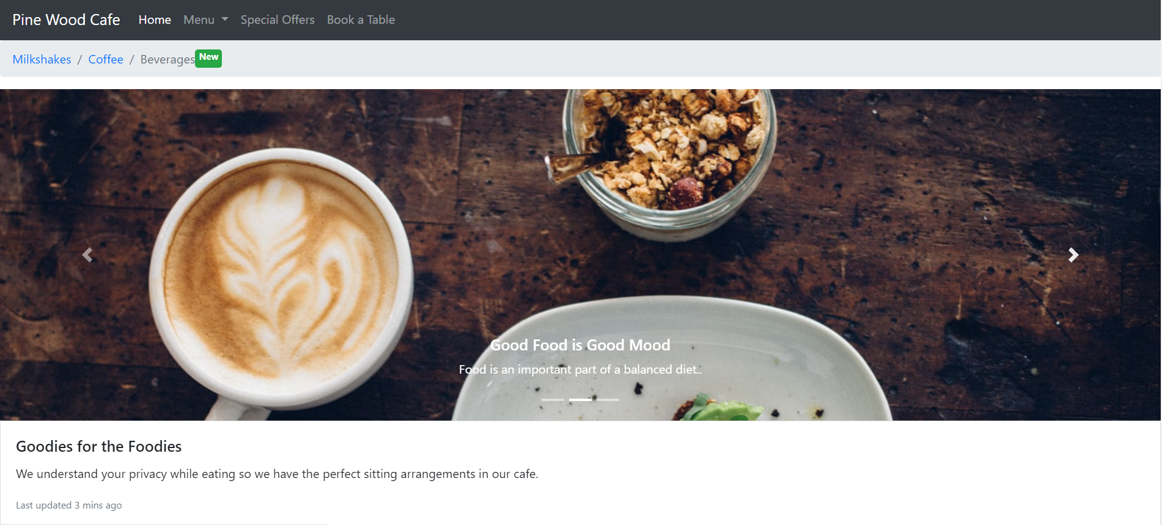
OUR SECTIONS

Slide 4
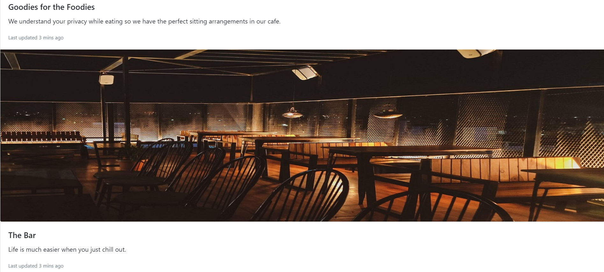
OUR PAGES

Slide 5
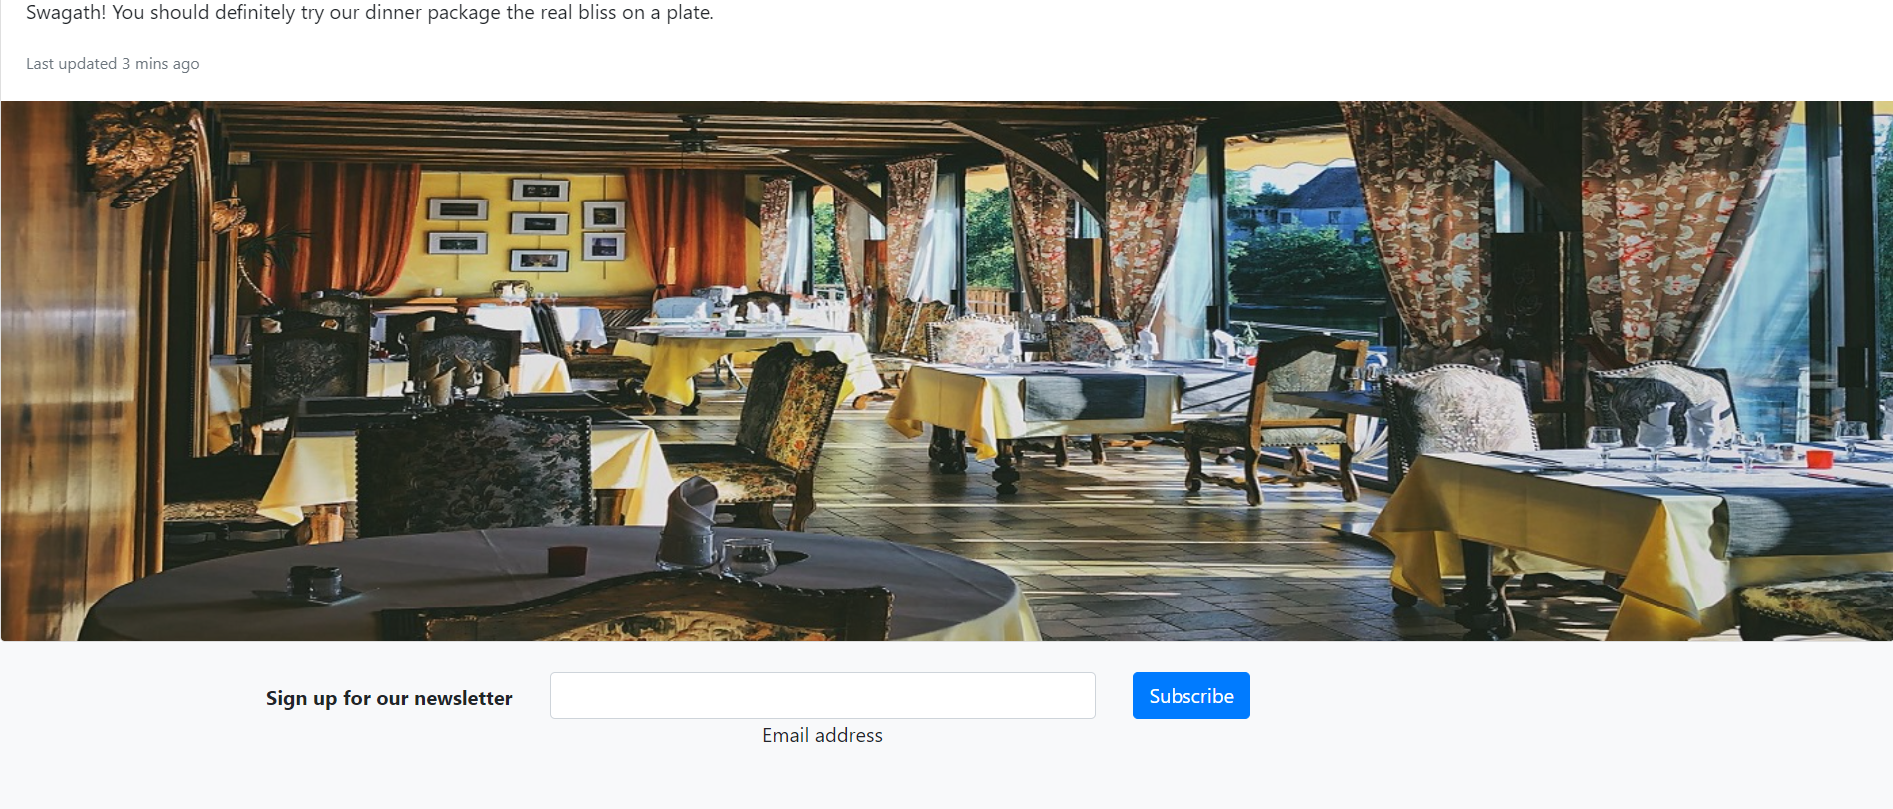
SIGN UP FOR NEWSLETTER

Slide 6
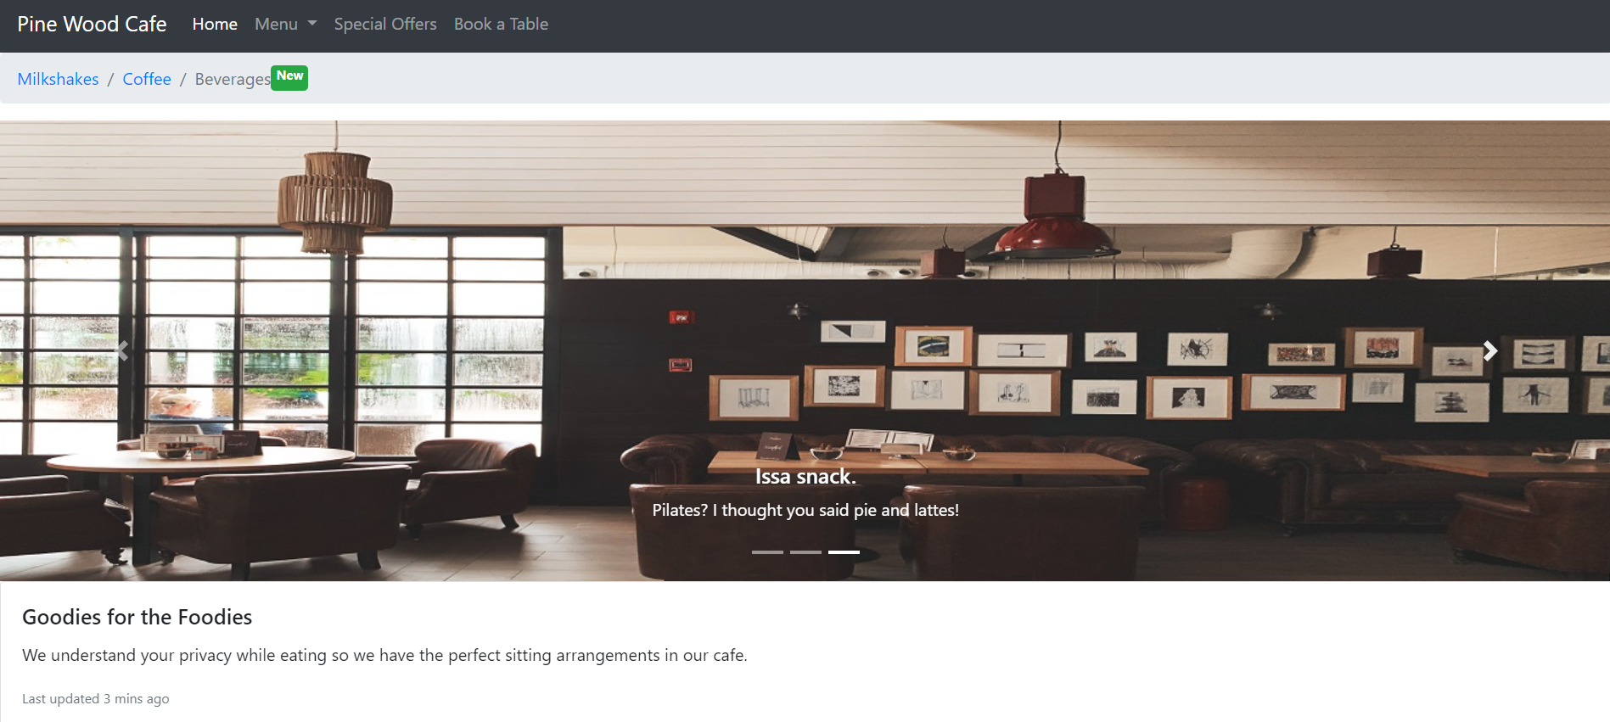
CLICK MENU

Slide 7
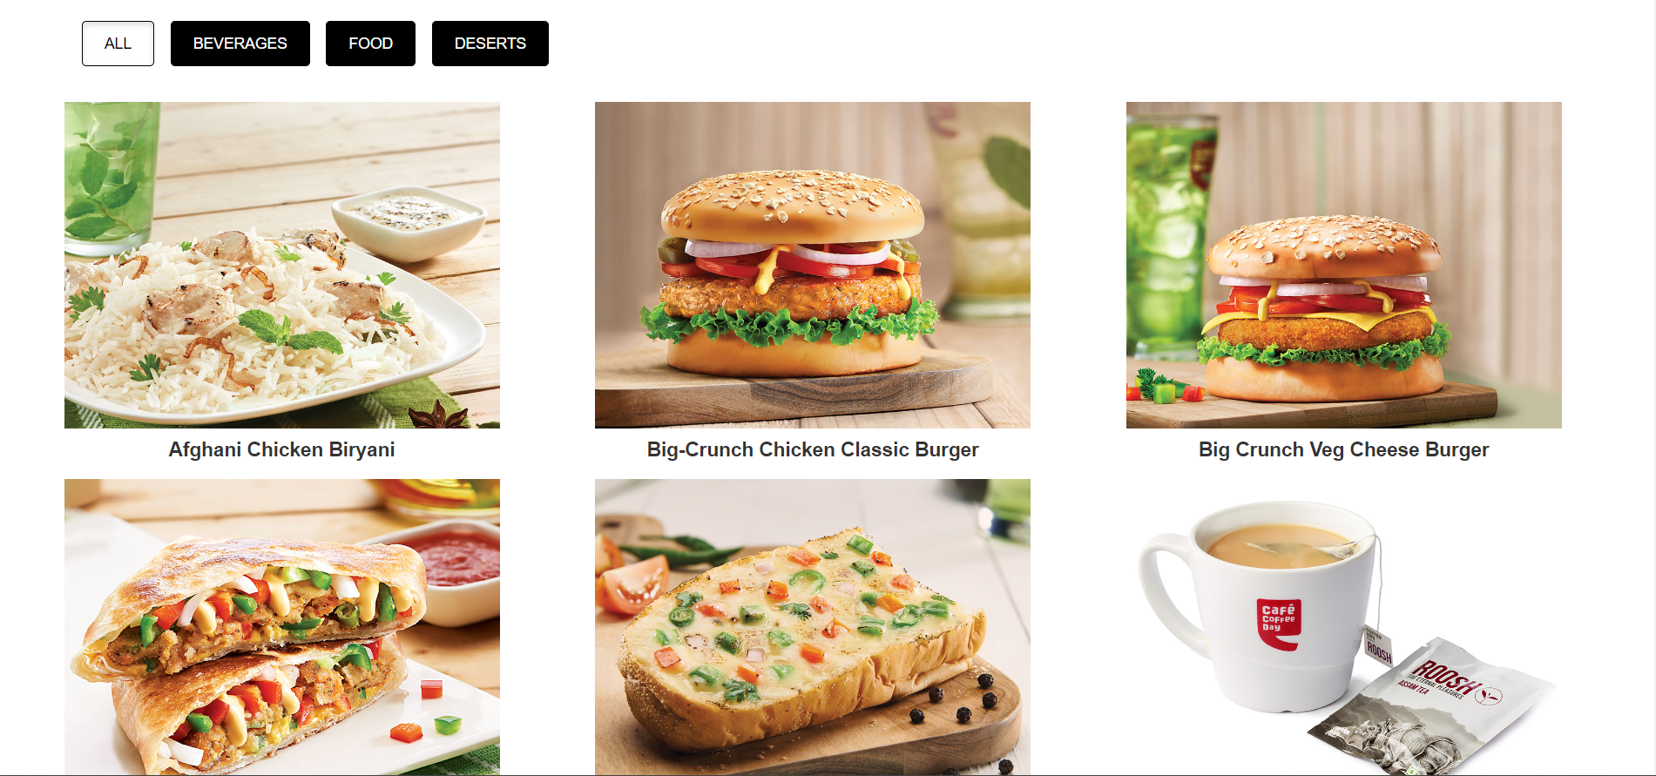
OUR FOOD MENU

Slide 8
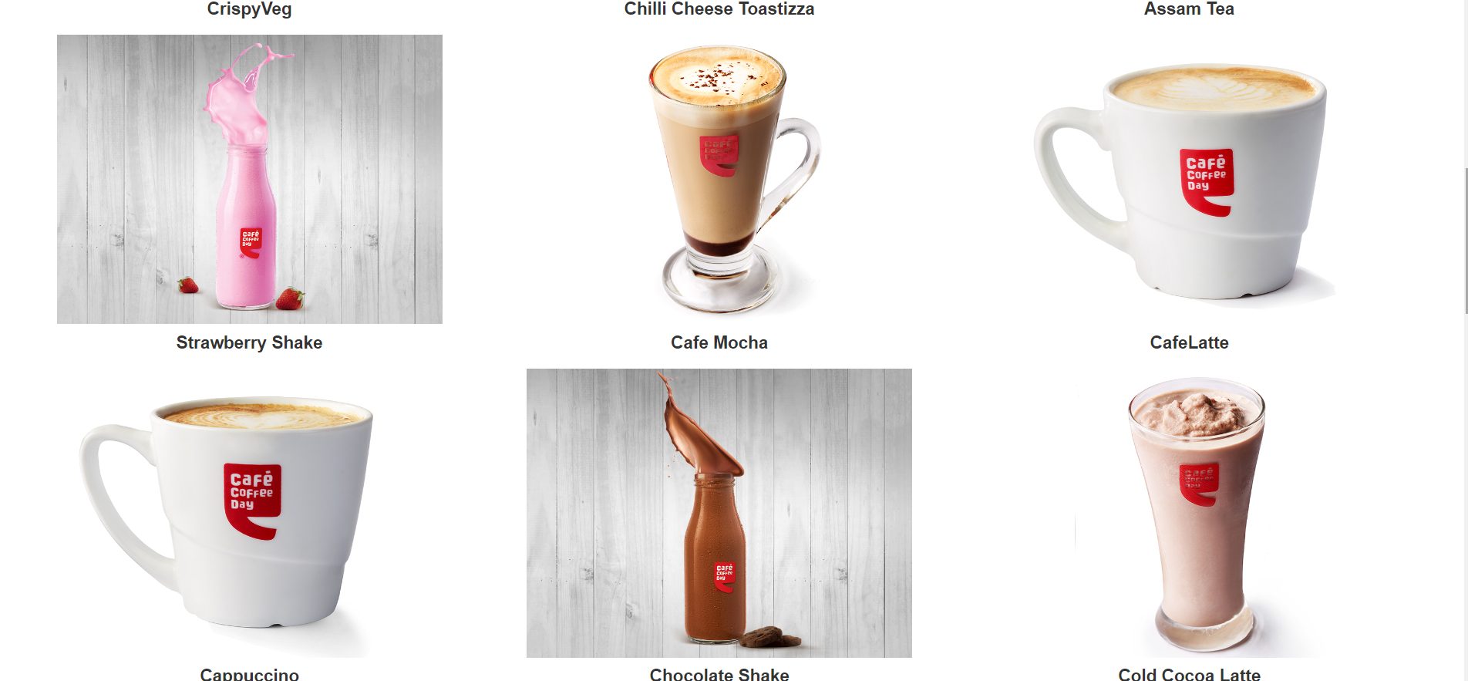

Slide 9
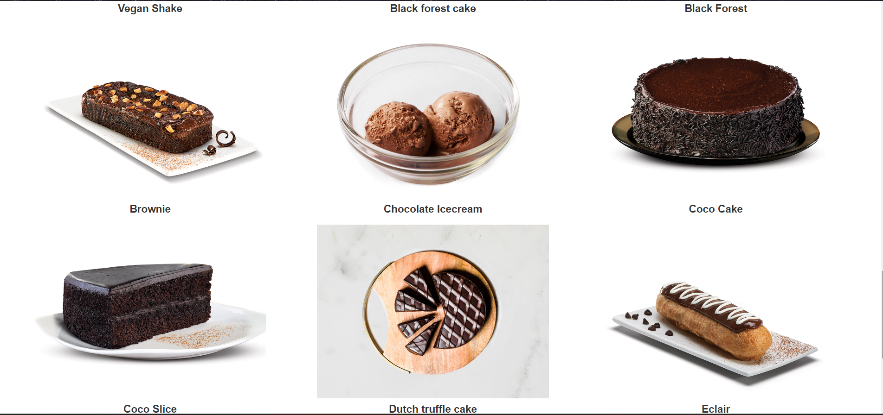

Slide 10
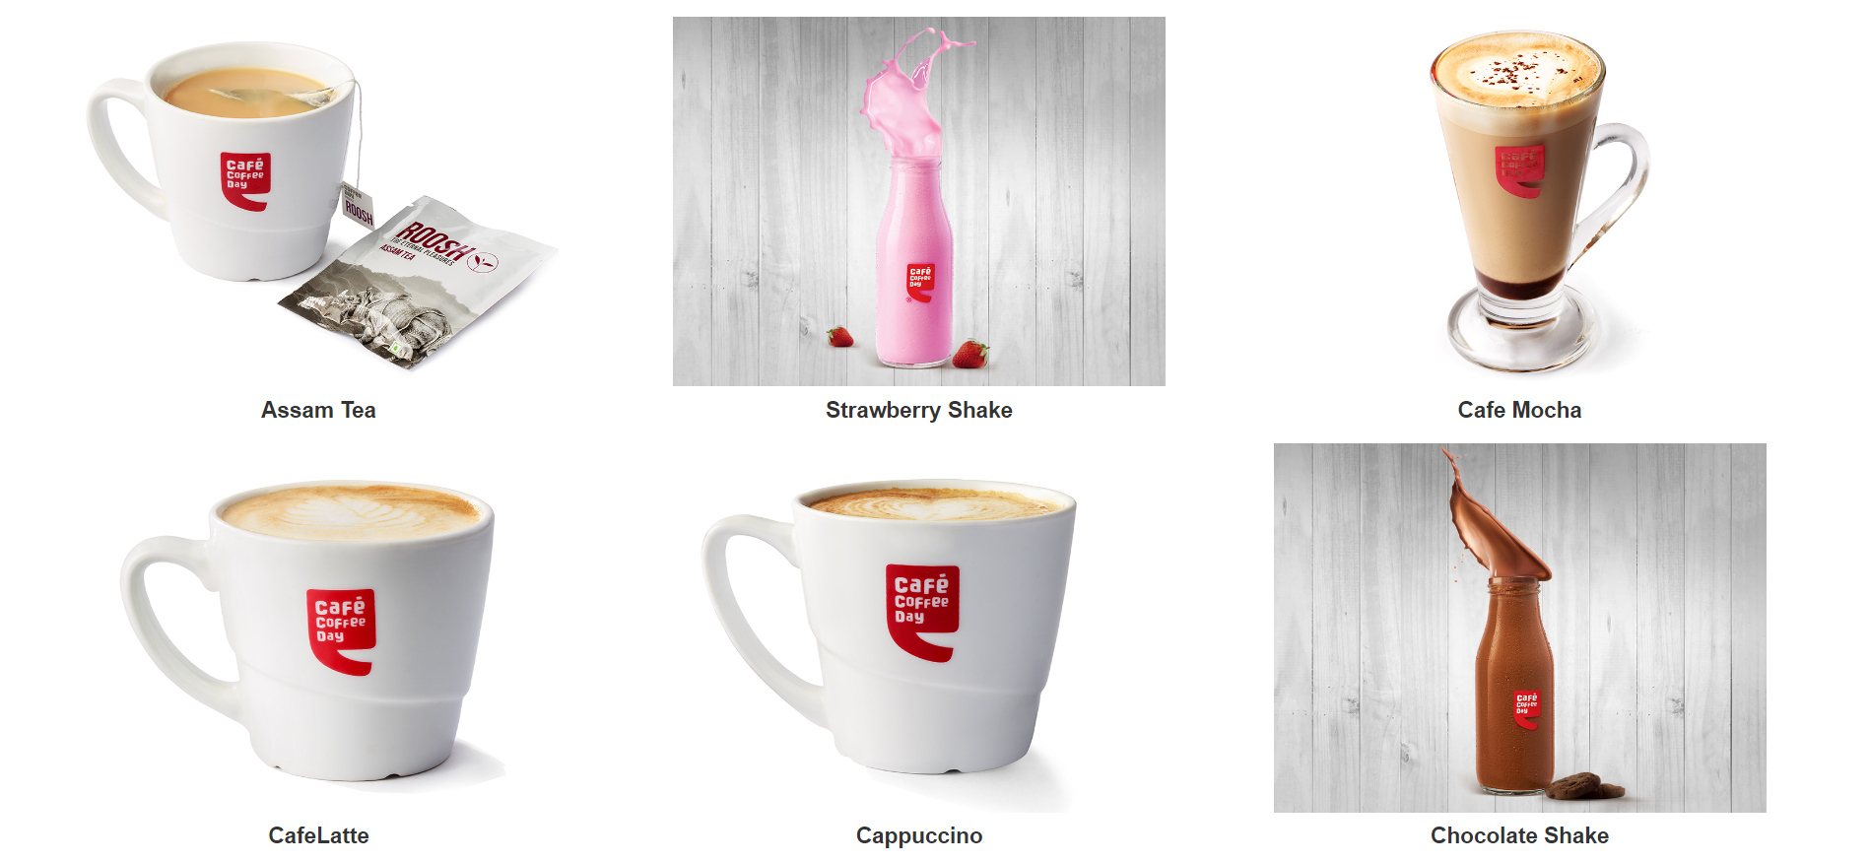
OUR MENU

Slide 11
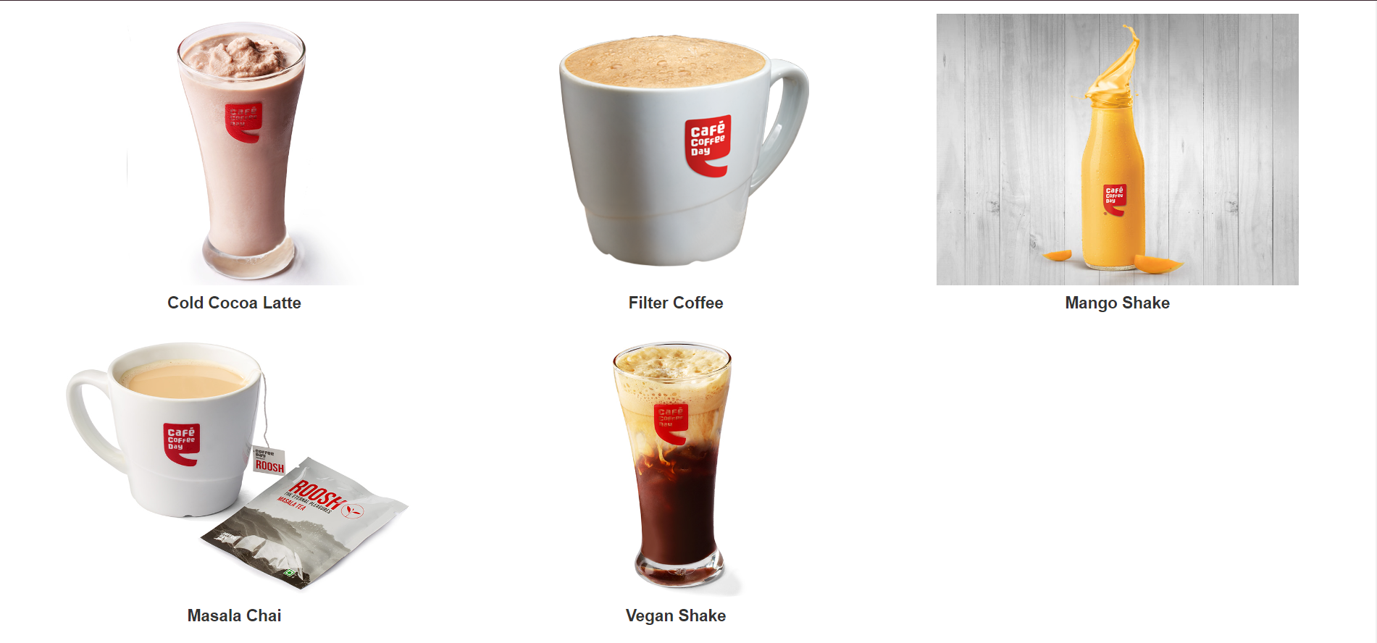

Slide 12
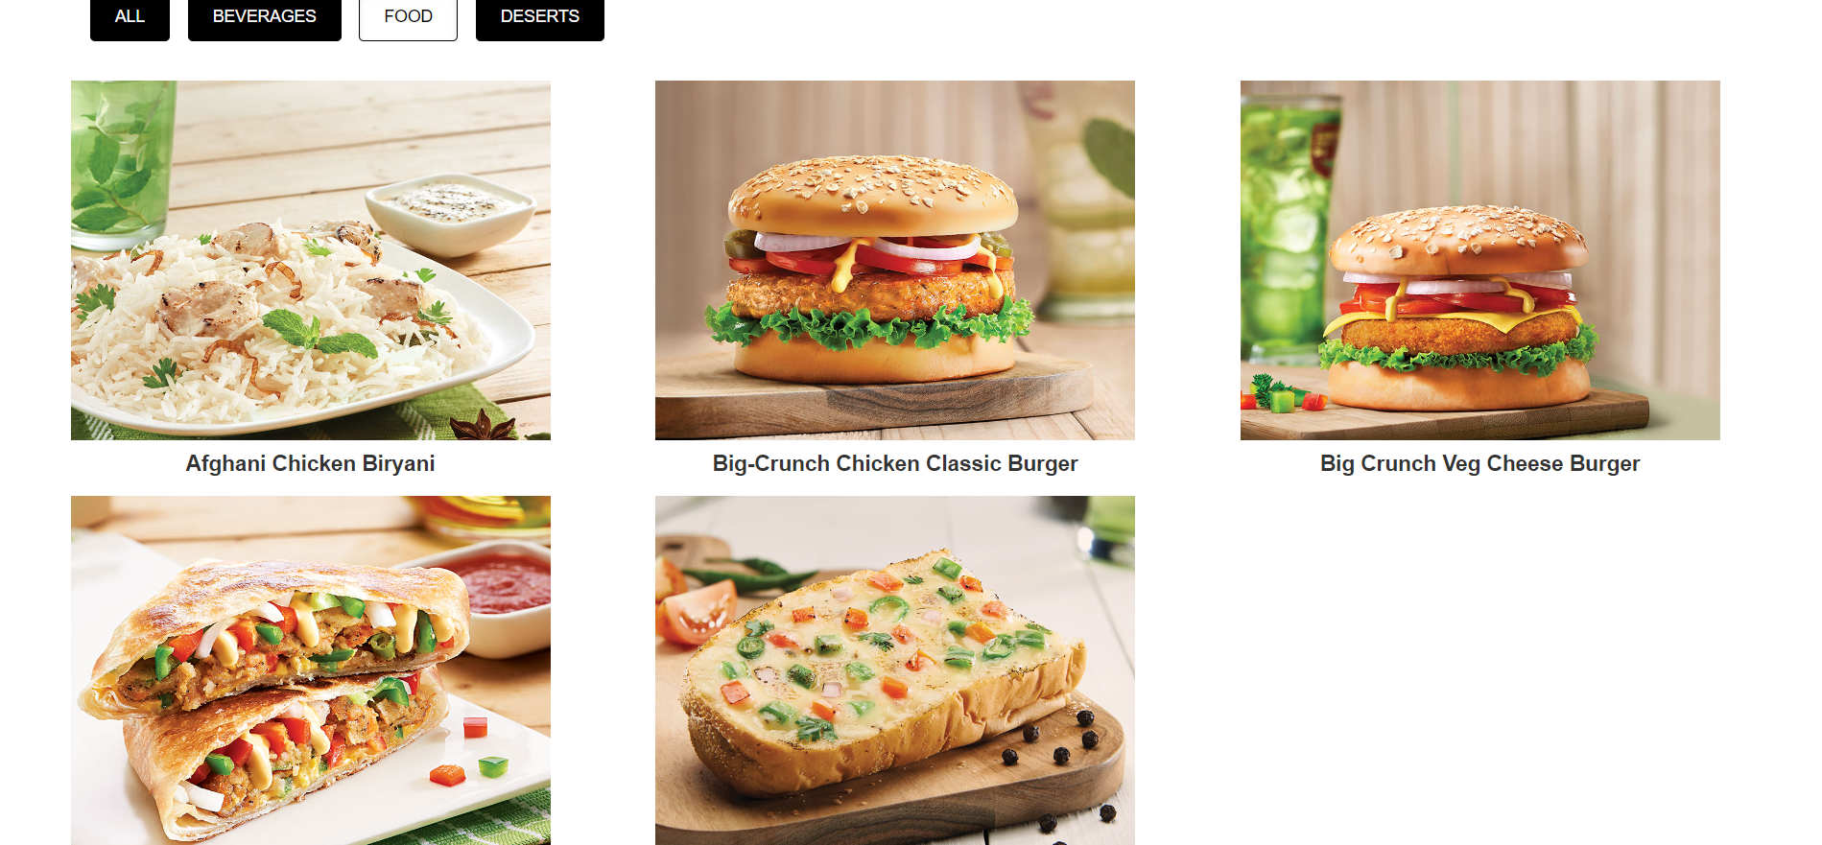

Slide 13
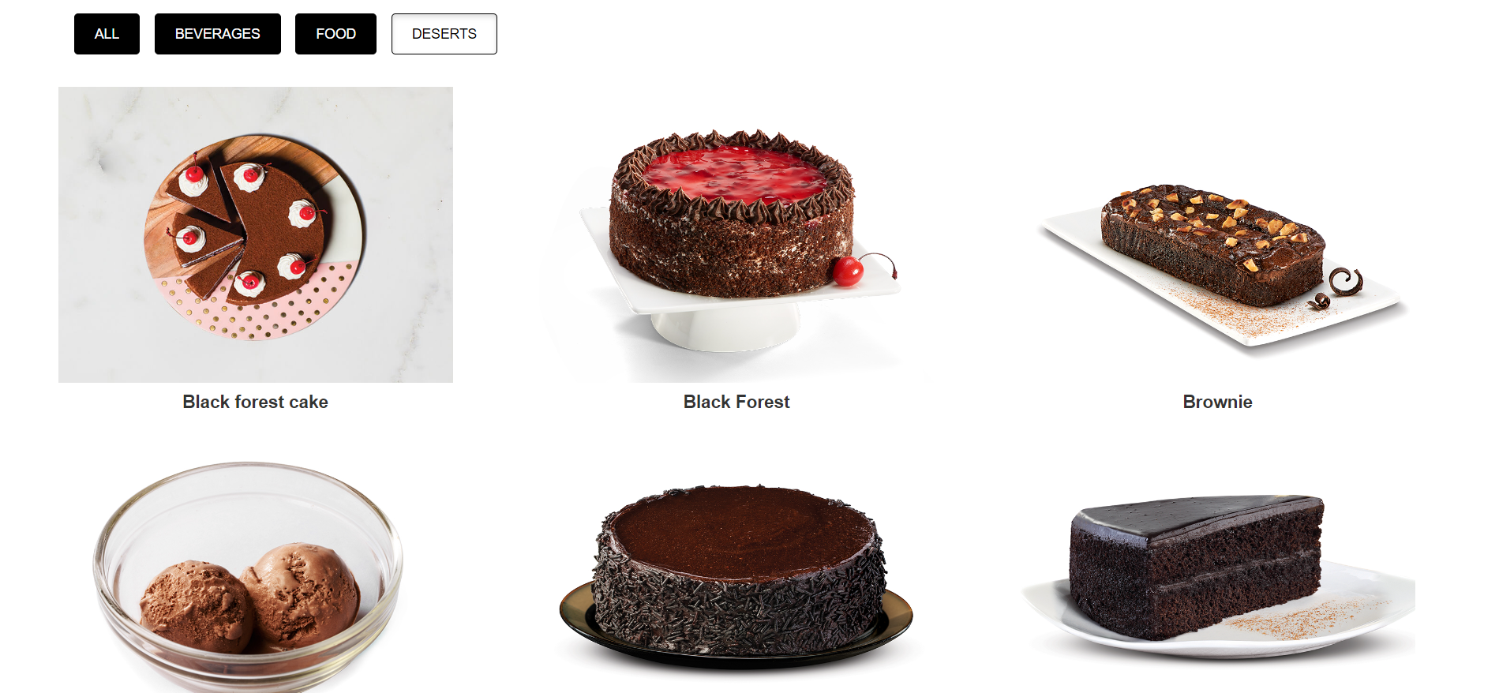

Slide 14


Slide 15
CLICK SPECIAL OFFERS

Slide 16
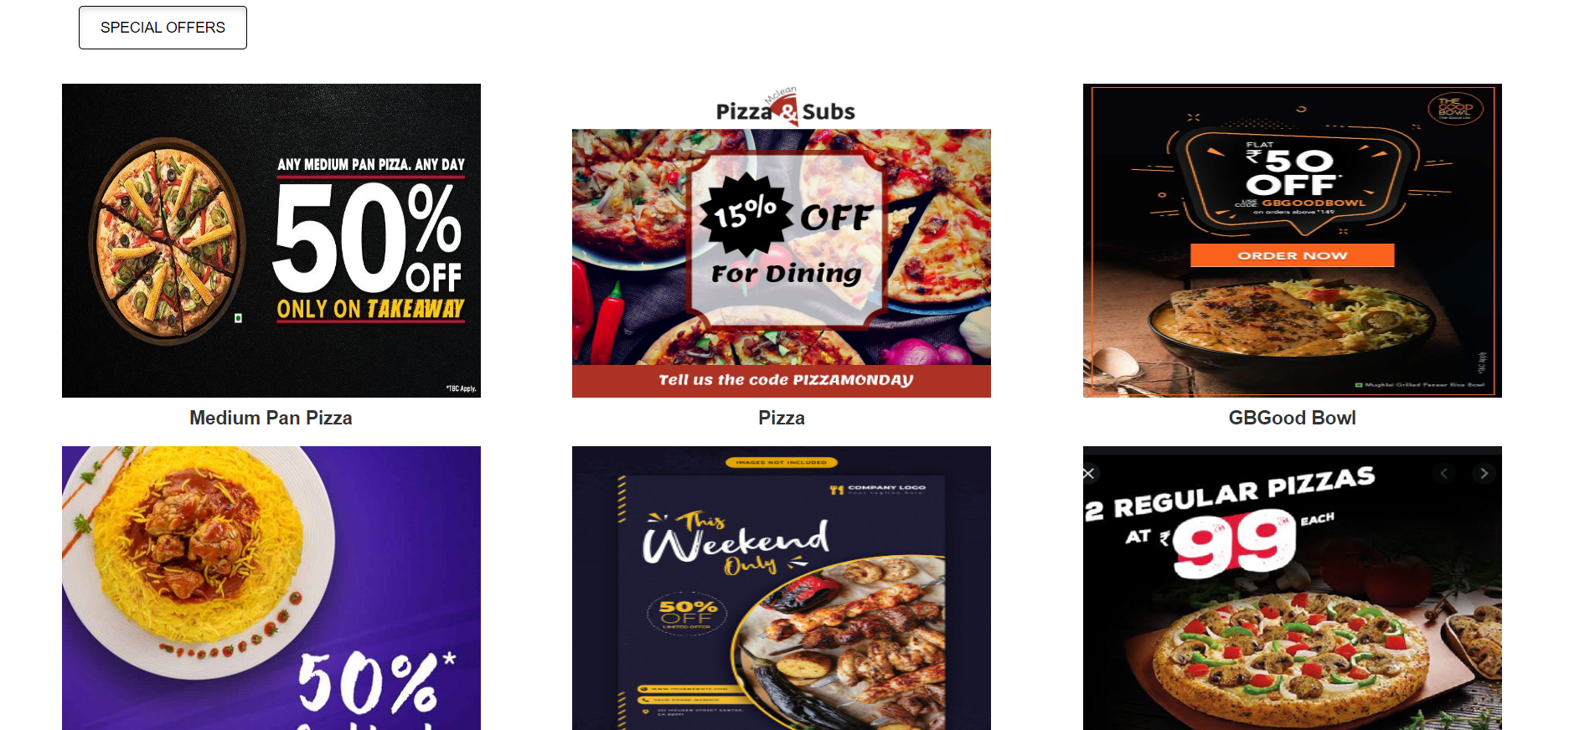
Offers

Slide 17
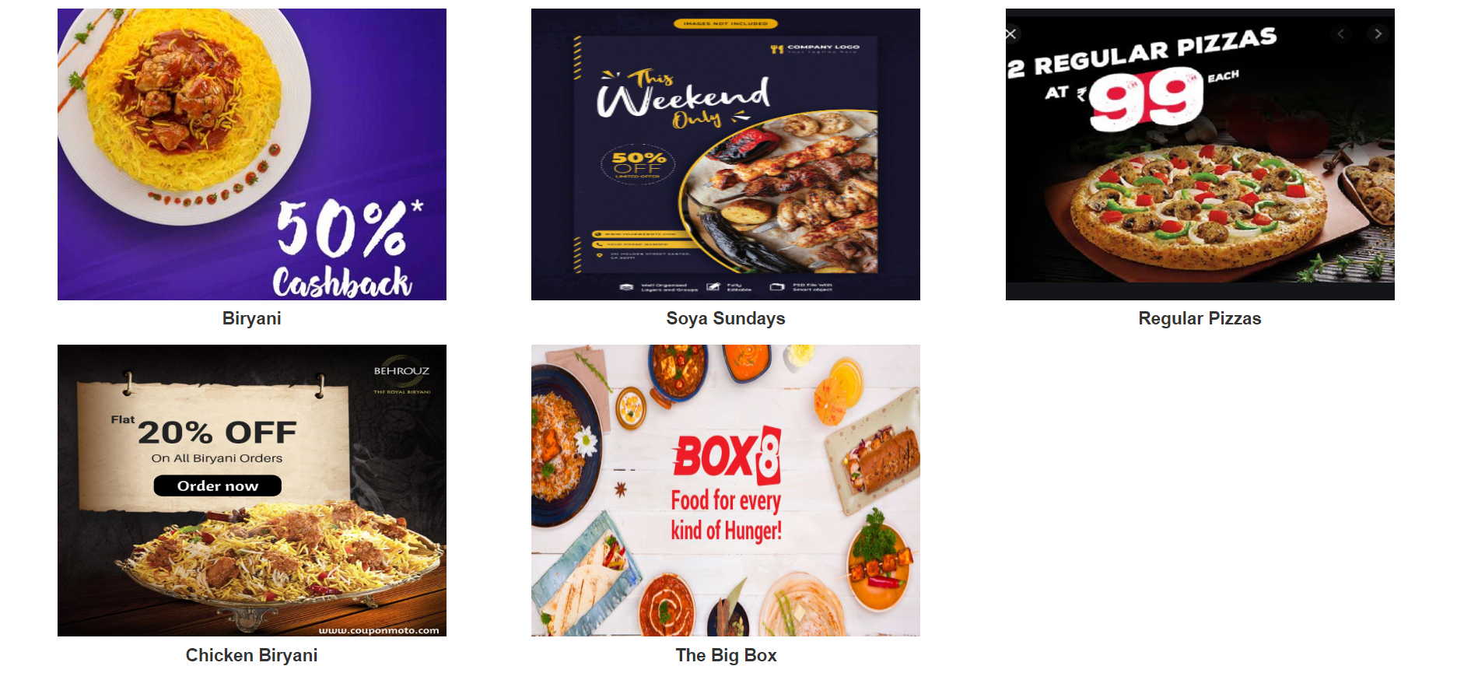

Slide 18
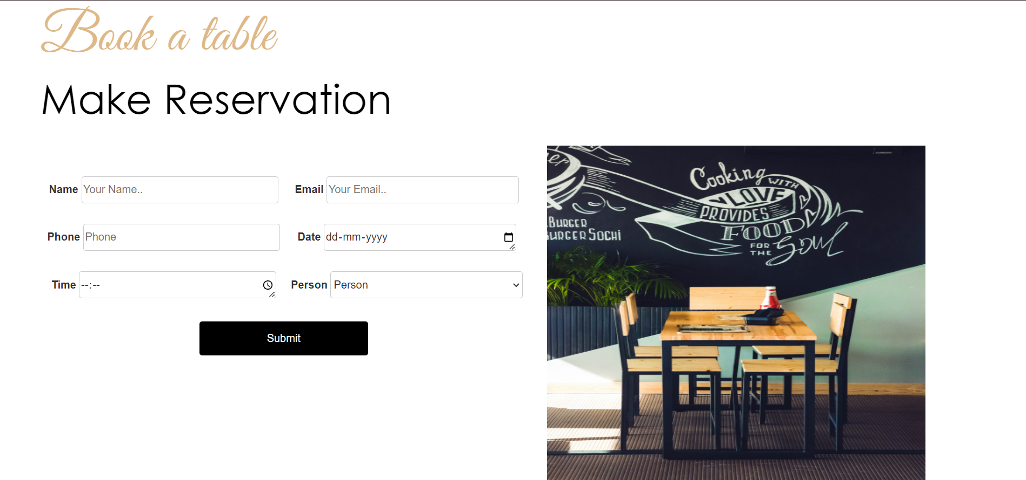
BOOK YOUR OWN TABLE

Slide 19
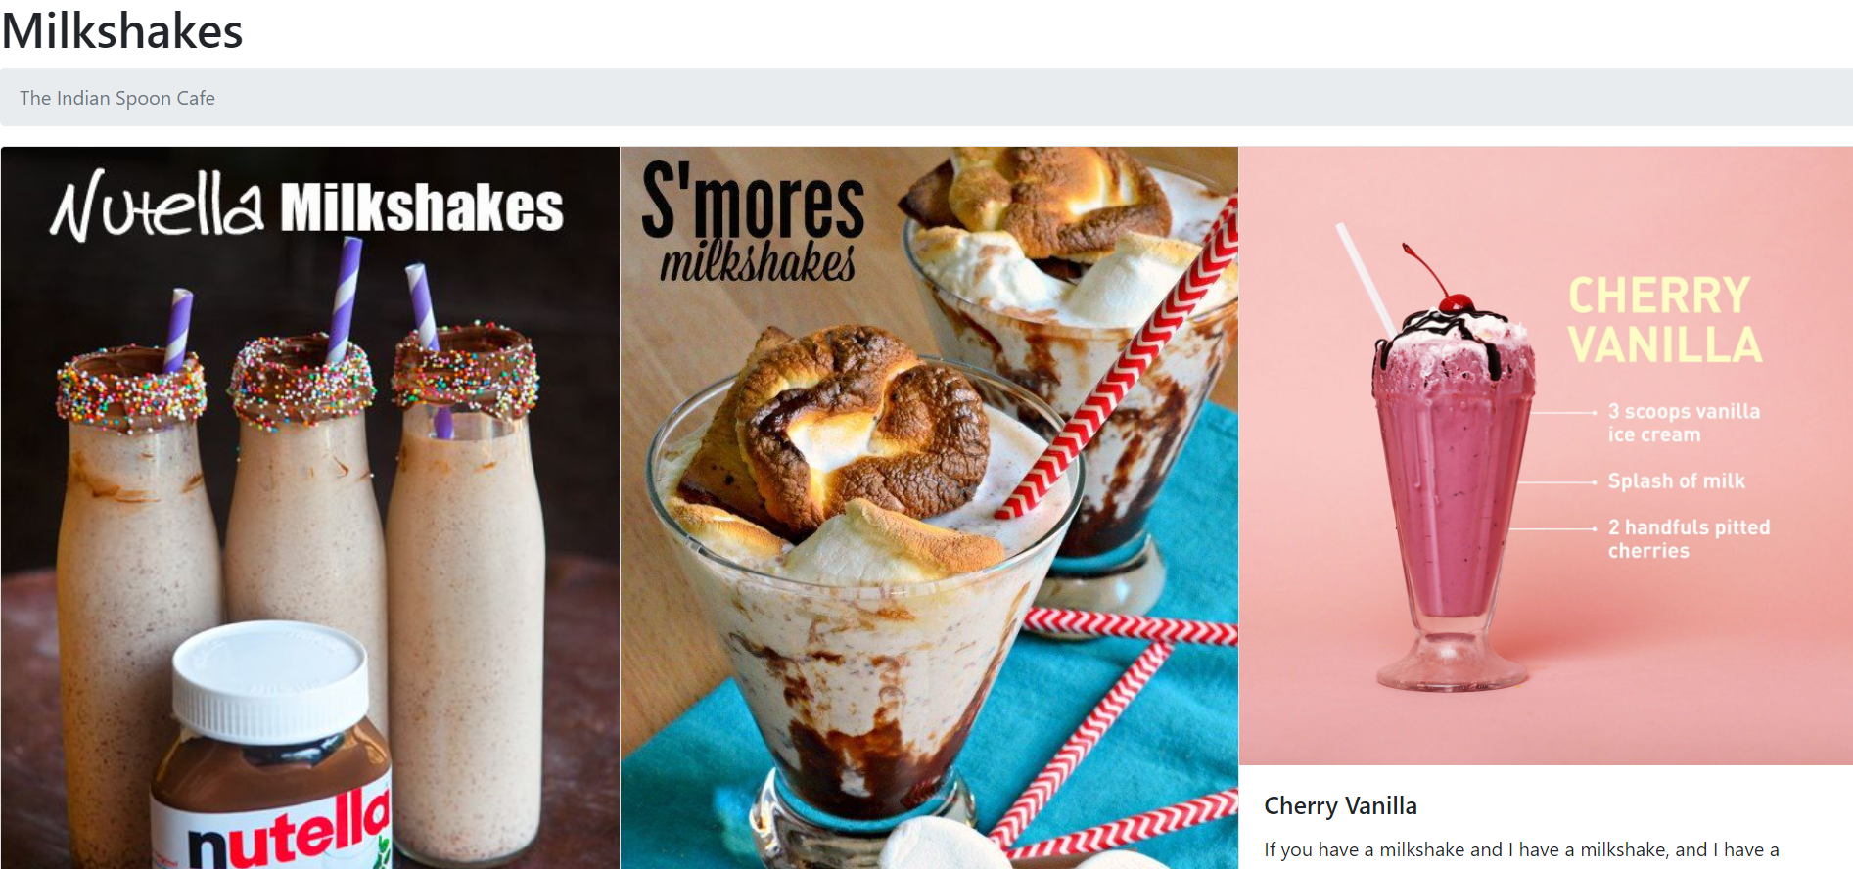
CHOOSE YOUR MILKSHAKE

Slide 20

CHOOSE YOUR COFFEE

Slide 21

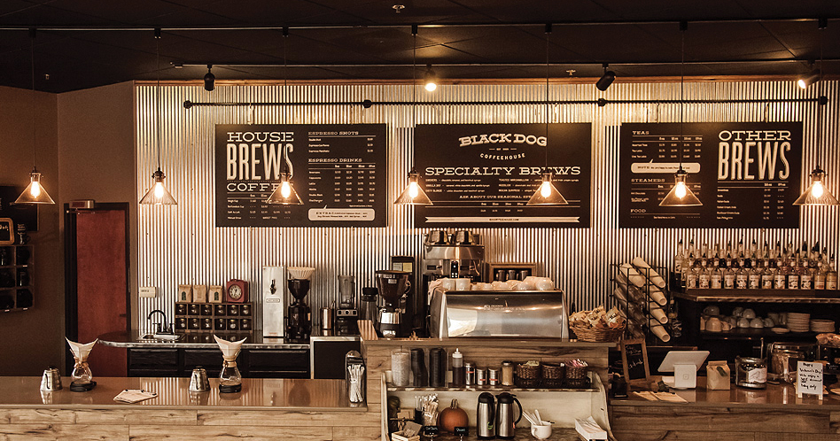
THANK YOU

